Slide 1
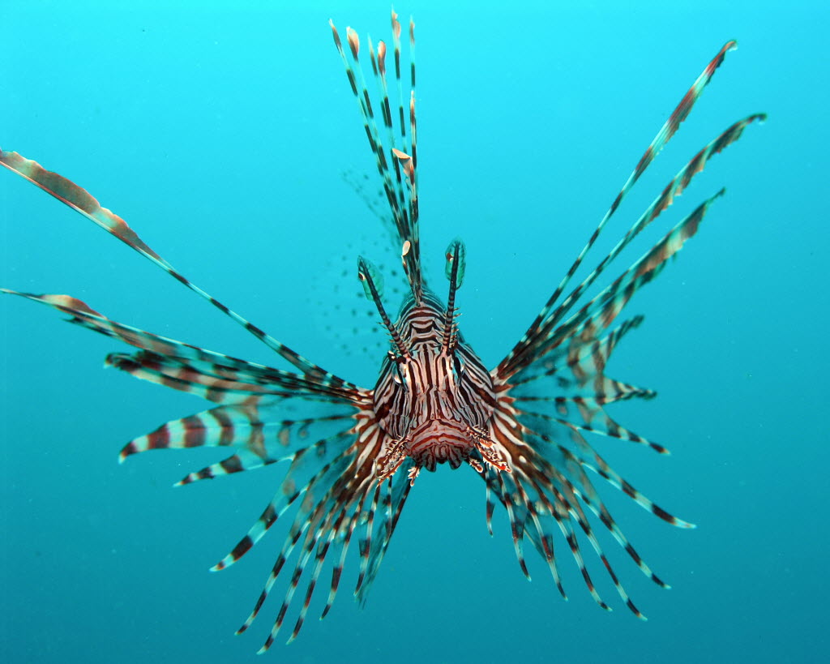
Modeling of potential control measures for the Lionfish invasion in USVI
Biomathmatics II
Math 452
By:
Amber DesRosiers
Eric Broussard
Kary Ritter

Slide 2
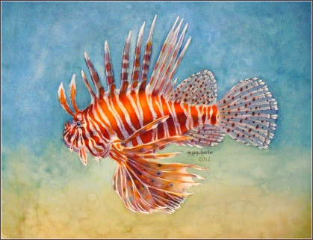
Outline
Lionfish invasion
Lionfish problem
Predator-prey model
Model Inputs
Model variables and calculations
Python modeling
Proposed control methods
Future studies

Slide 3
What are Lionfish?
Venomous marine fish native to the Indo-Pacific
Red, white, creamy, or blank bands with spiky fin rays
Range in size from 2 to 18 inches
Adults weigh between 300 and 400 grams
Can live up to 18 years
Notes:
Lionfish is a genus of venomous marine fish native to the Indo-Pacific. Lionfish are characterized by warning coloration with red, white, creamy, or black bands and showy pectoral fins and venomous spiky fin rays. Lionfish in the Atlantic range from 2.0 in 18 in in length, and weigh from 25 grams to 1.3 kilograms . Lionfish can live from five to 18 years.

Slide 4
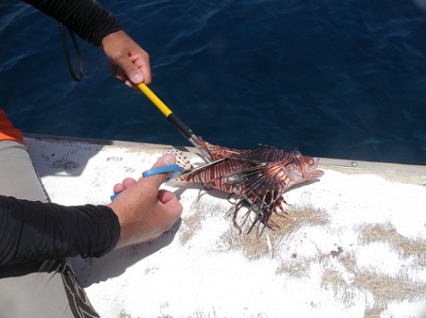
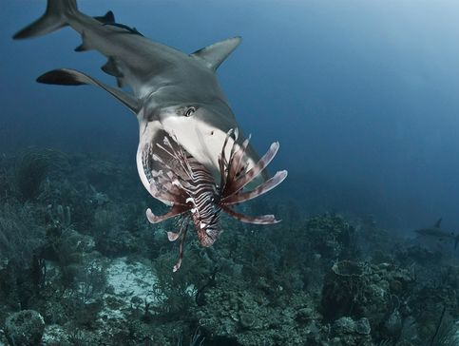
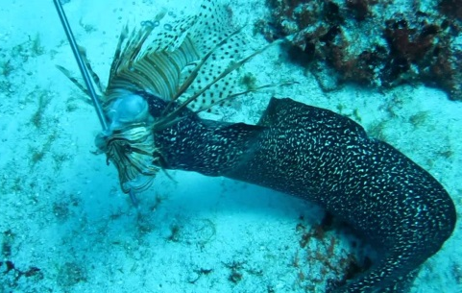
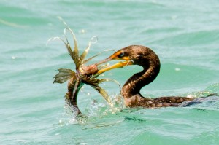
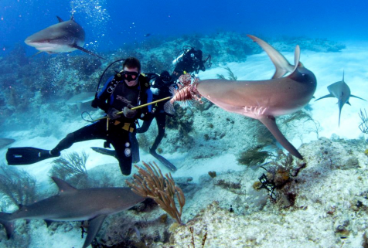
Lionfish Invasion
Reproduction - every 4 days
Spawn over 2 million eggs/year
Consume over 70 species of fish
Eat prey up to half their body length
Who is eating the Lionfish?
moray eel, sharks, grouper, humans ~ not really
Notes:
moray eel, sharks, grouper, humans
Train sharks.
Dense lionfish populations can consume more than 460,000 prey fish/acre/year •
On heavily invaded sites, lionfish have reduced their fish prey populations by up to 90% and continue to consume native fishes at unsustainable rates

Slide 5
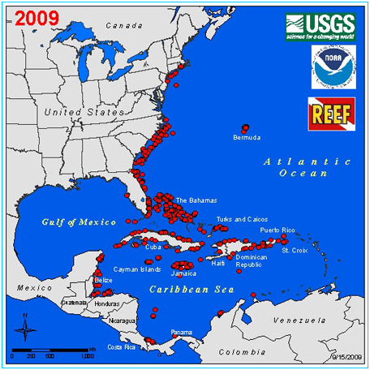
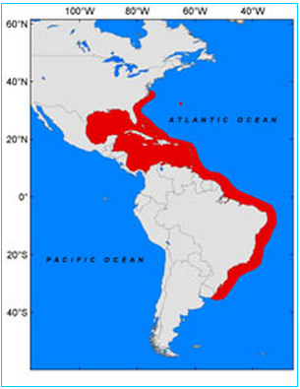
Lionfish Problem
2009 estimate
Future estimate
(Morris & Akins, 2009)
Notes:
Reproduction occurs throughout the year about every 4 days • In the Caribbean, a single female lionfish can spawn over 2 million eggs/year
Problem: Lionfish are generalist carnivores that consume over 70 species of fish and many invertebrate species, capable of eating prey up to half their body length

Slide 6
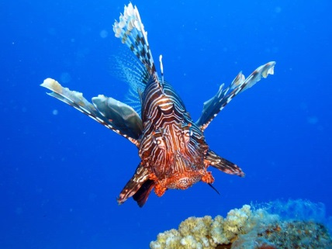
Lionfish Problem in USVI
Lionfish may cause deleterious changes in coral reef ecosystems
Capable of removing prey community
Lionfish eat the fish that eat the algae choking the coral reefs and the coral dies
Eat 85% of hatchlings of native fish
USVI economic HIT ~ 300 to 500 million
University of Virgin Islands
Notes:
The invasion is a major threat to coral reef ecosystems in the Caribbean region because the lionfish decrease the survival rate of a wide range of native reef fish by both predation and competition. Lionfish have no natural predators. Potential predators seem to largely avoid consuming the lionfish and therefore the lionfish population has increased 13 to 15 fold. Lionfish may cause changes in the coral reef ecosystems via predation on native fish and competition with native predators. There is evidence that lionfish are capable of removing up to 79% of the prey community on isolated patch reefs. Such rates of reduction in coral fish abundances cannot be sustained.
potential $300-million to $500-million hit that could come as early as a few years from now, a gathering at the University of the Virgin Islands was told

Slide 7
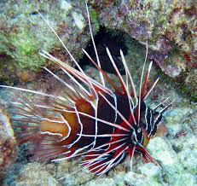
Why are we looking at this problem?
To date only one study has explored the level of harvest required
Results suggested 27% of adult population would have to be killed monthly
Unclear whether removal efforts can reduce lionfish population
Notes:
To date, there is only one evaluation that has explored the level of harvest required to substantially reduce the lionfish population. The study showed that just to maintain current lionfish population densities, at least 27% of the invasive adult populations would have to be killed monthly. As expected, additional harvesting of juveniles would reduce this percentage. The fact that the lionfish are able to reproduce monthly throughout the entire year means that this is an effort that must be maintained monthly indefinitely. It is unknown whether removal efforts can substantially reduce lionfish population numbers so this problem will no longer be of concern so we wanted to look further into this problem.

Slide 8
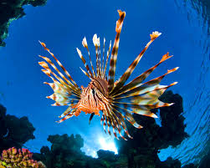
Why do we need to model?
How much harvesting of lionfish is needed in USVI to bring their population to equilibrium?
Can humans harvesting help?
Can biocontrol help?
Potential of Grouper biocontrol
of lionfish?

Slide 9
Predator-Prey Modeling

Slide 10
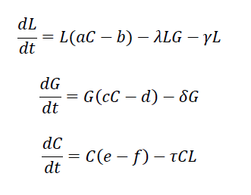
Initial Proposed Model
Lionfish
Grouper
Coral fish

Slide 11
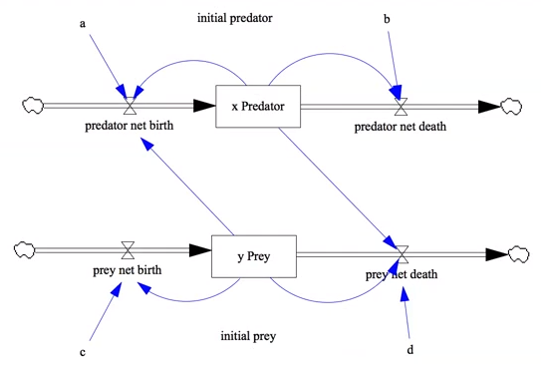
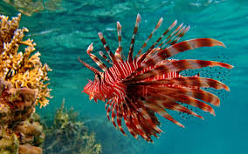
Lotka-Volterra Model
Notes:
2 stocks - Initial populations of predator and prey
What goes into the predator – Net birth and net death. Rates a and b feeding the births and deaths of predator.
Net birth of pred dependant on availability of prey
Prey net birth – dependent on (availability of prey) & (constant c)
Prey net death – driven availability of predator meaning – More pred. more death of prey

Slide 12
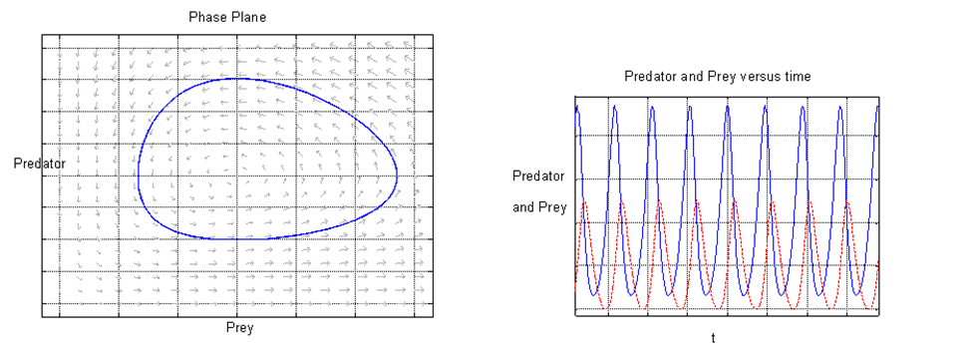
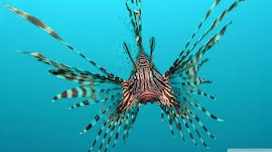
Predator-Prey Model
Notes:
These graphs show that as Prey increases then Predators start to grow, then the Predators start to eat up the Prey but keep growing.
Soon the Predators run out of food and start to die off quickly and then the Prey starts growing again.

Slide 13
Model Inputs
Lionfish, Grouper, & Coral fish

Slide 14
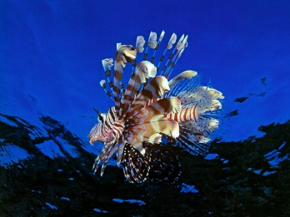
Resources for model inputs

Slide 15
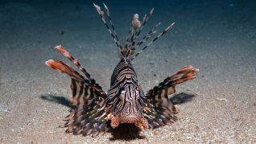
Lionfish inputs
Notes:
Local park lionfish experts contacted and little information given
bg: per capita increase of predators/prey grouper/yr
dg: death rate of predators
bl: intrinsic growth rate of prey lionfish/yr
dl: reduction in prey/pred
bc: intrinsic growth rate of prey coral fish/yr
dc: reduction in prey/pred

Slide 16
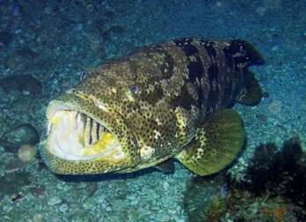
Grouper inputs

Slide 17
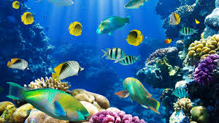
Coral fish inputs
(M. a. Albins & Hixon, 2011; Barbour et al., 2011; Baskett, 2006; Cerino, 2010; Darling et al., 2011; Hackerott et al., 2013; Kellner, Litvin, Hastings, Micheli, & Mumby, 2010; Leung et al., 2011; Monaco et al., 2007; Morris & Akins, 2009; Morris & Whitfield, 2009; Muñoz, Currin, & Whitfield, 2011; NOAA, USGS, & REEF, 2011; Sadovy & Eklund, 1999; Waddell & Clarke, 2008)

Slide 18
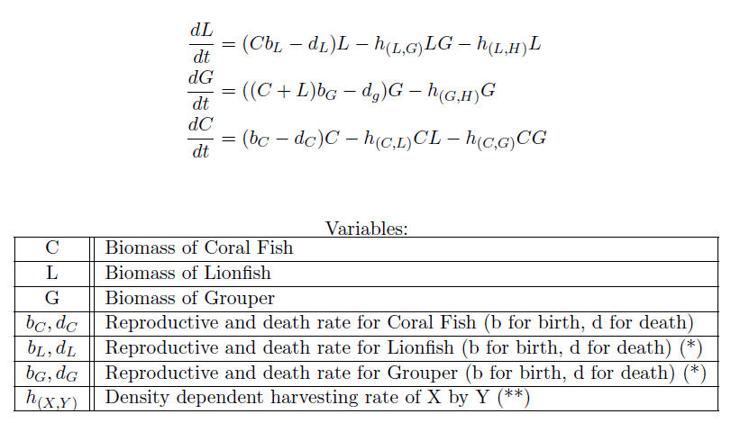


Initial Model
Lionfish
Grouper
Coral fish
Notes:
bg: per capita increase of predators/prey grouper/yr
dg: death rate of predators
bl: intrinsic growth rate of prey lionfish/yr
dl: reduction in prey/pred
bc: intrinsic growth rate of prey coral fish/yr
dc: reduction in prey/pred

Slide 19
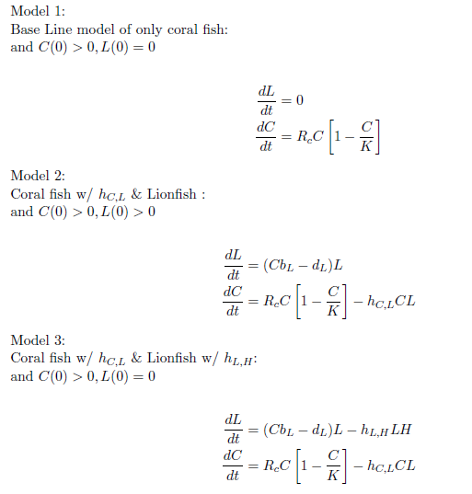
Revised Model

Slide 20
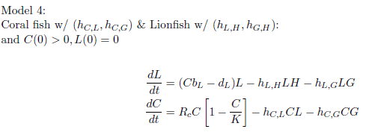
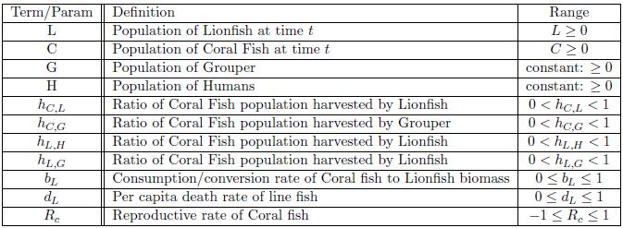
Revised Model

Slide 21
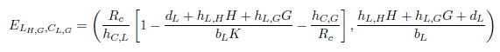
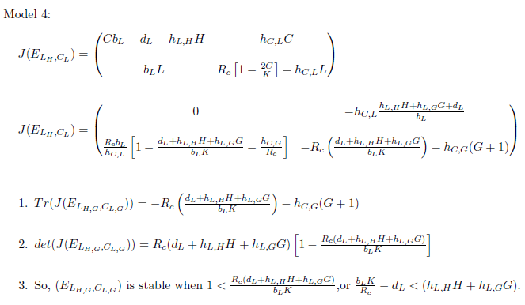
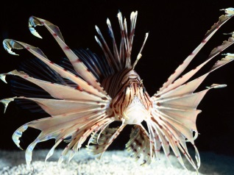
Model Calculations
Equilibrium points
Stability analysis

Slide 22
Harvesting

Slide 23
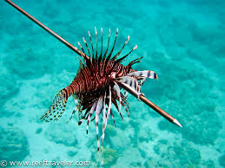
Human harvesting
Human | Lionfish
Full time diver | 3000-4000/yr
Competitions | 1400/competition
Lionfish density at 200/acre (USGS 2011)
~6.5 million in USVI (50 miles²)
Current Human Effort
0.41% Lionfish/year
USVI Current
Harvesting Efforts
6 full time divers
4 competitions per year
~26.6K lionfish harvested/humans/yr
Notes:
On USVI website = current harvesting 26K
Lionfish at 300 meters aren’t fished
Increasing by 10 fold would equal 4.1% when according to one study 27% is needed per month

Slide 24

Python Modeling

Slide 25
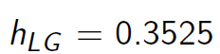
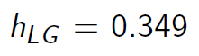
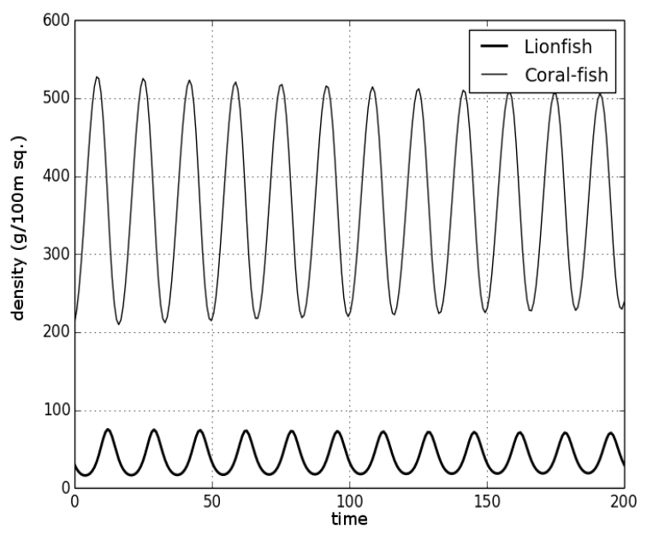
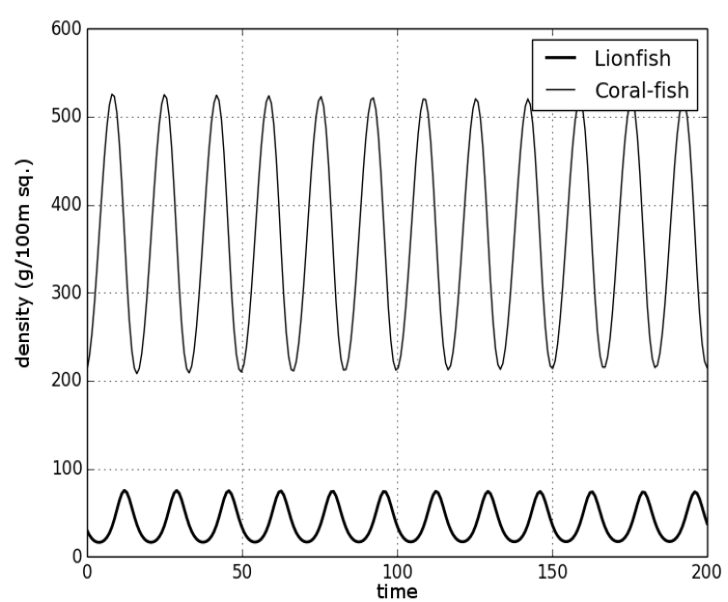

Python Modeling
biomass (g/100m²
biomass (g/100m²

Slide 26
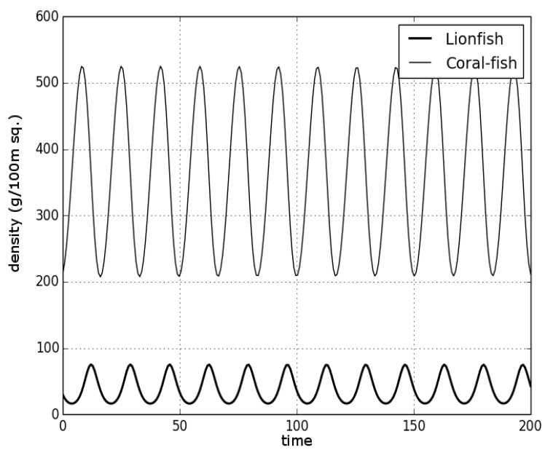
Grouper Harvesting Rate
Needed
h_{LG} =0.35
Current
h_{LG} =0.0009
biomass (g/100m²
Notes:
Per year
.09%

Slide 27
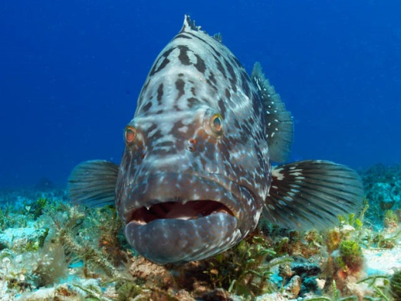
Proposed control methods
What if there was more Grouper?

Slide 28
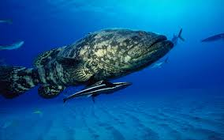
Actual density relationship
How can we get this?
1800% increase G
700% decrease L
Exuma Cays Land and Sea Park, Bahamas
(Mumby, Harborne, & Brumbaugh, 2011)
Notes:
Areas of different densities of lionfish and grouper were analyzed
Largest adult lionfish ~ 300-400 g
Average is 140g
Exuma Cays Land and Sea Park
Assuming grouper eating lionfish
How can we get this 3000g/100m2 ?

Slide 29
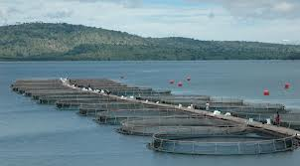
Grouper Aquaculture
Based off grouper aquaculture in Thailand, China, Liao, Taiwan (Rimmer, 1998; Tucker, 1999)
Assuming 50% grouper leave area
~17.2 million lbs/grouper/year needed
Notes:
Using estimates from grouper aquaculture in South East Asia
3yr payback
USVI

Slide 30
Python Modeling with Grouper Aquaculture

Slide 31
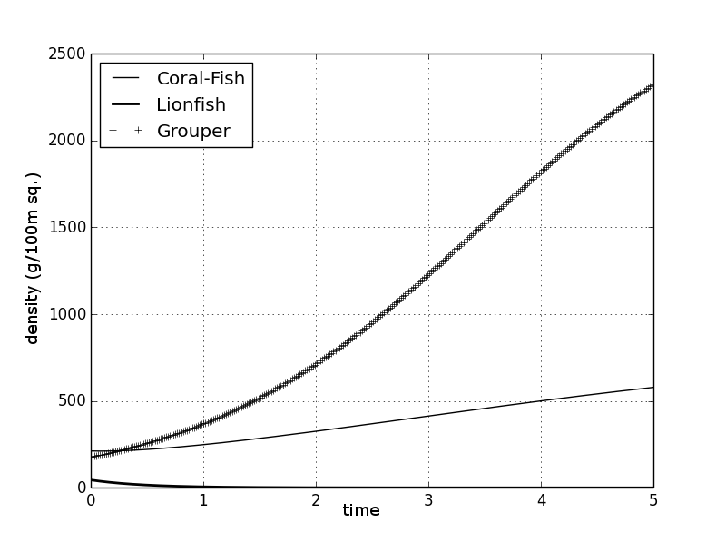
Density relationship from model
For low lionfish concentrations
biomass (g/100m²
Notes:
C0 = 212
L0 = 45
G0 = 178
K = 800
RC = .447
dl = .3 #roughly the lifespan of a fish that live 15-20 years
bl = .05
grouper_harv = .349
lion_attack = 8.6/240

Slide 32
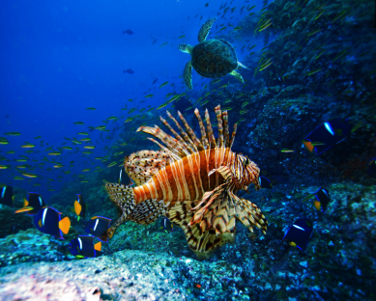
Future Studies
Quantifying lionfish natural mortality and the size-selective vulnerability to harvest.
Role that small-bodied grouper may play, particularly in preying upon juvenile lionfish
Economic incentives, such as the development of a commercial market for lionfish
Notes:
Quantifying lionfish natural mortality and the size-selective vulnerability to harvest are the most important knowledge gaps for future research (Barbour et al., 2011).
Laboratory and field trials are needed to understand the size-dependency of the predator-prey relationship and the role that small-bodied grouper and other piscivores may play, particularly in preying upon juvenile lionfish (Mumby et al., 2011)
Economic incentives, such as the development of a commercial market for lionfish - which is beginning to happen in some parts of the Caribbean - might help make direct interventions a cost- effective option(Mumby et al., 2011).

Slide 33
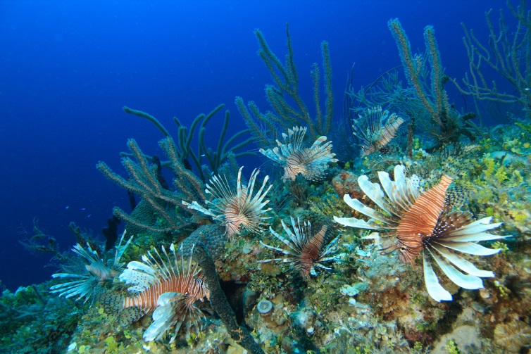
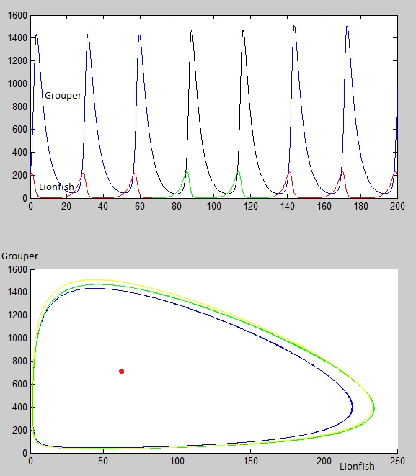
Questions
Grouper
Lionfish

Slide 34
Matlab model

